Slide 1
Chapter 3 :: Sequential Logic Design
Digital Design and Computer Architecture
David Money Harris and Sarah L. Harris
Lectured by Jeong-Gun Lee @ Hallym
Copyright © 2007 Elsevier
3-<<number>>

Slide 2
Chapter 3 :: Topics
Introduction (소개)
Latches and Flip-Flops (래치와 플립플롭)
Synchronous Logic Design (동기식 회로 설계)
Finite State Machines (유한 상태 기계)
Timing of Sequential Logic (순차회로의 타이밍)
Parallelism (병렬성)
Copyright © 2007 Elsevier
3-<<number>>

Slide 3
Introduction
Outputs of sequential logic depend on current and prior input values.
(순차회로의 출력은 현재의 입력과 과거의 입력 값에 의존한다.)
Sequential logic thus has memory. (따라서 메모리 갖음)
Some definitions:
  State (상태): contains all the information about a circuit necessary to explain its future behavior
  Latches and flip-flops: state elements that store one bit of state
  Synchronous sequential circuits: combinational logic followed by a bank of flip-flops
Copyright © 2007 Elsevier
3-<<number>>

Slide 4
Sequential Circuits
give sequence to events (순서화 기능)
have memory (short-term)
use feedback from output to input to store information
Copyright © 2007 Elsevier
3-<<number>>

Slide 5
State Elements (상태 요소)
The state of a circuit determines its future behavior
State elements store state
  Bistable circuit
  SR Latch
  D Latch
  D Flip-flop
Copyright © 2007 Elsevier
3-<<number>>

Slide 6
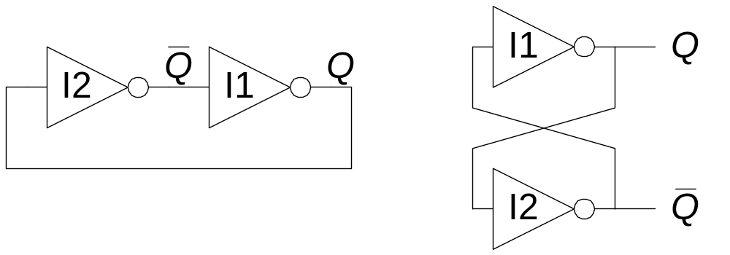
Bistable Circuit
Fundamental building block of other state elements
Two outputs: Q, Q
No inputs
Copyright © 2007 Elsevier
3-<<number>>

Slide 7
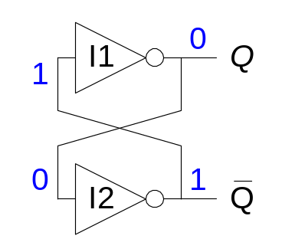
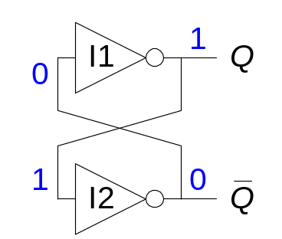
Bistable Circuit Analysis
Consider the two possible cases:
  Q = 0: then Q = 1 and Q = 0 (consistent)
  Q = 1: then Q = 0 and Q = 1 (consistent)
Bistable circuit stores 1 bit of state in the state variable, Q (or Q )
But there are no inputs to control the state
Copyright © 2007 Elsevier
3-<<number>>

Slide 8
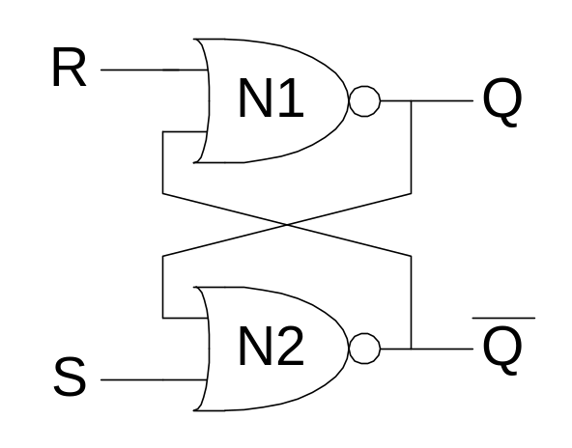
SR Latch
Set/Reset Latch (SR Latch)
Definitions
  Set: Make the output 1
  Reset: Make the output 0
When the set input, S, is 1 (and R = 0), Q is set to 1
When the reset input, R, is 1 (and S = 0), Q is reset to 0
Copyright © 2007 Elsevier
3-<<number>>

Slide 9
SR Latch Analysis
Consider the four possible cases:
  S = 1, R = 0
  S = 0, R = 1
  S = 0, R = 0
  S = 1, R = 1
Copyright © 2007 Elsevier
3-<<number>>

Slide 10
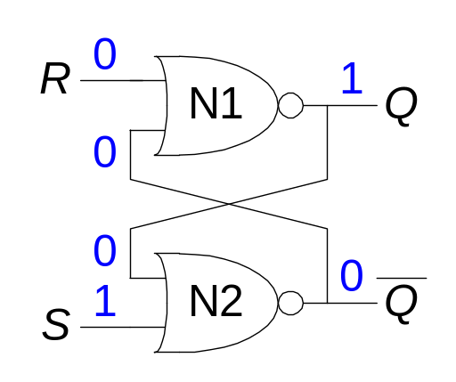
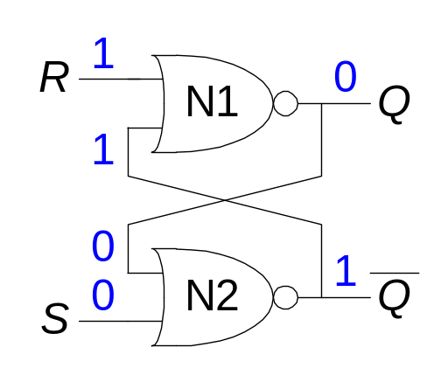
SR Latch Analysis
  S = 1, R = 0: then Q = 1 and Q = 0
  S = 0, R = 1: then Q = 0 and Q = 1
Copyright © 2007 Elsevier
3-<<number>>

Slide 11
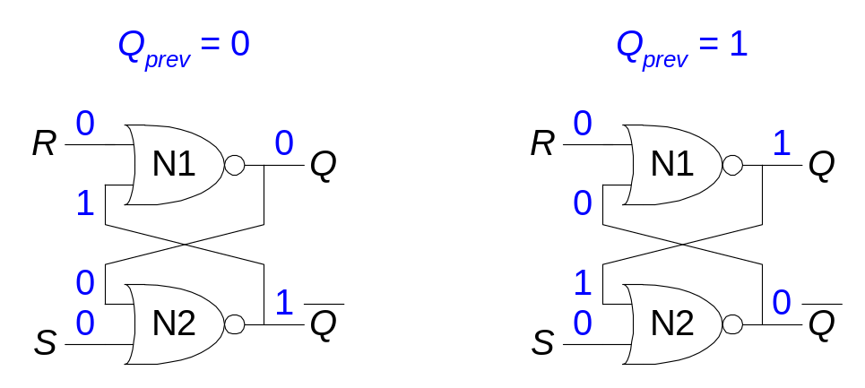
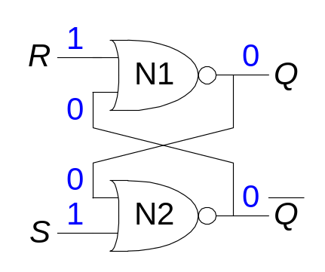
SR Latch Analysis
  S = 0, R = 0: then Q = Q_{prev} and Q = Q_{prev} (memory!)
  S = 1, R = 1: then Q = 0 and Q = 0 (invalid state: Q ≠ NOT Q)
Copyright © 2007 Elsevier
3-<<number>>

Slide 12
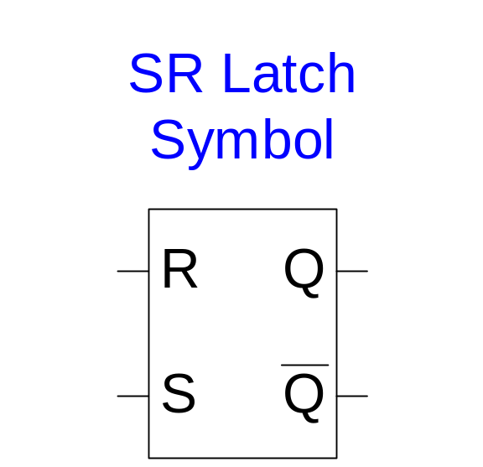
SR Latch Symbol
Stores one bit of state (Q)
Can control what value is being stored with S, R inputs
Invalid state when S = R = 1
Copyright © 2007 Elsevier
3-<<number>>

Slide 13
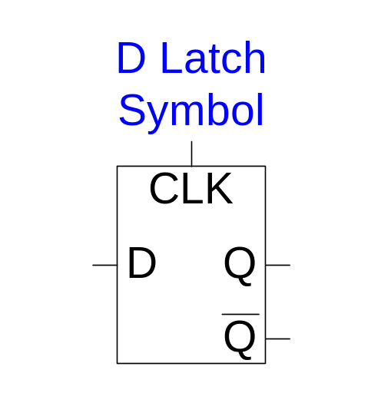
D Latch
Two inputs: CLK, D
CLK: controls when the output changes
D (the data input): controls what the output changes to
Avoids invalid case when Q ≠ NOT Q
When CLK = 1, D passes through to Q (the latch is transparent:투명)
When CLK = 0, Q holds its previous value (the latch is opaque:불투명)
Copyright © 2007 Elsevier
3-<<number>>

Slide 14
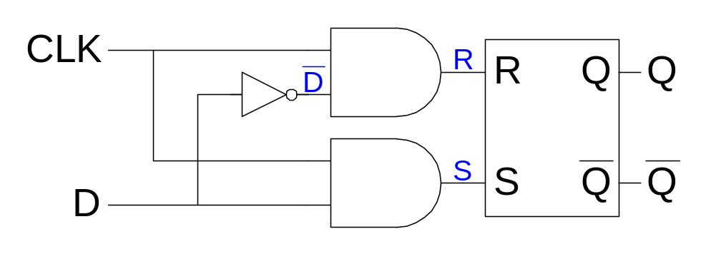
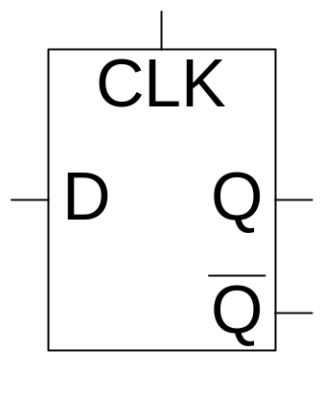
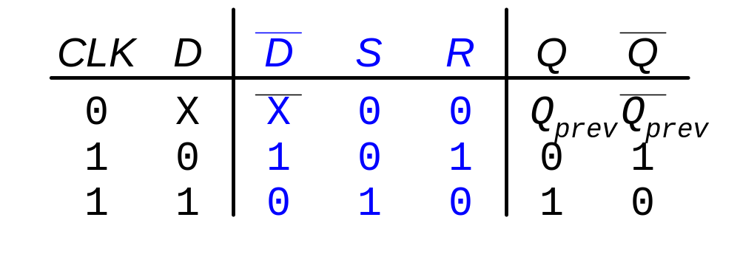
D Latch Internal Circuit
Copyright © 2007 Elsevier
3-<<number>>

Slide 15
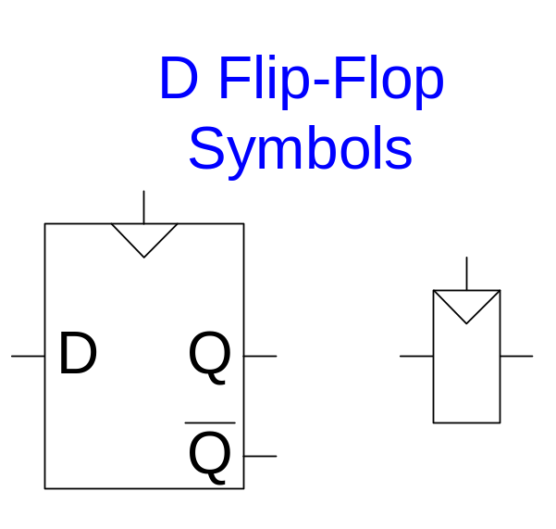
D Flip-Flop
Two inputs: CLK, D
Q changes only on the rising edge of CLK
The flip-flop “samples” D on the rising edge of CLK
  When CLK rises from 0 to 1, D passes through to Q
  Otherwise, Q holds its previous value
Thus, a flip-flop is called an edge-triggered device because it is activated on the clock edge
Copyright © 2007 Elsevier
3-<<number>>

Slide 16
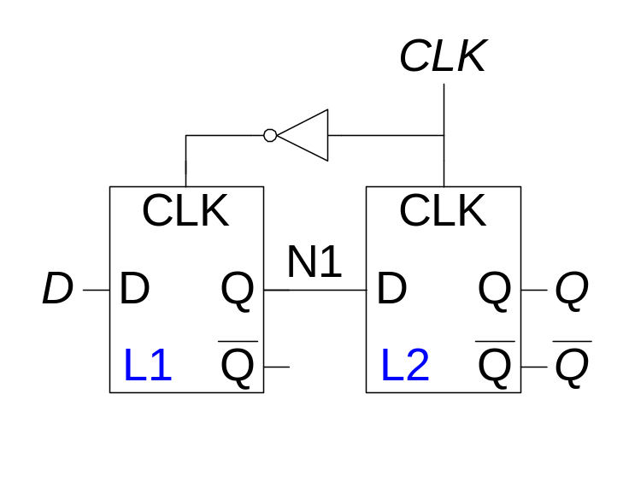
D Flip-Flop Internal Circuit
Two back-to-back latches (L1 and L2) controlled by complementary clocks
When CLK = 0
  L1 is transparent
  L2 is opaque
  D passes through to N1
When CLK = 1
  L2 is transparent
  L1 is opaque
  N1 passes through to Q
Thus, on the edge of the clock (when CLK rises from 0 1)
  D effectively passes through to Q
Copyright © 2007 Elsevier
3-<<number>>

Slide 17
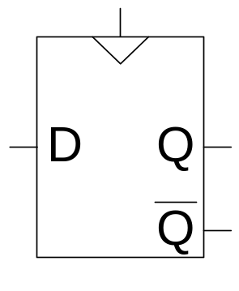
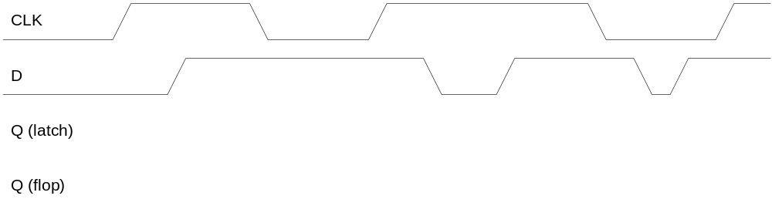
D Flip-Flop vs. D Latch
Copyright © 2007 Elsevier
3-<<number>>

Slide 18
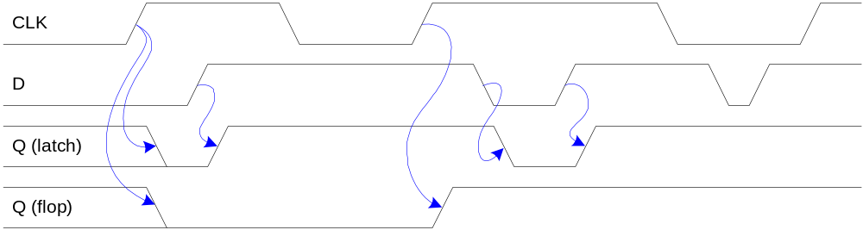
D Flip-Flop vs. D Latch
Copyright © 2007 Elsevier
3-<<number>>

Slide 19
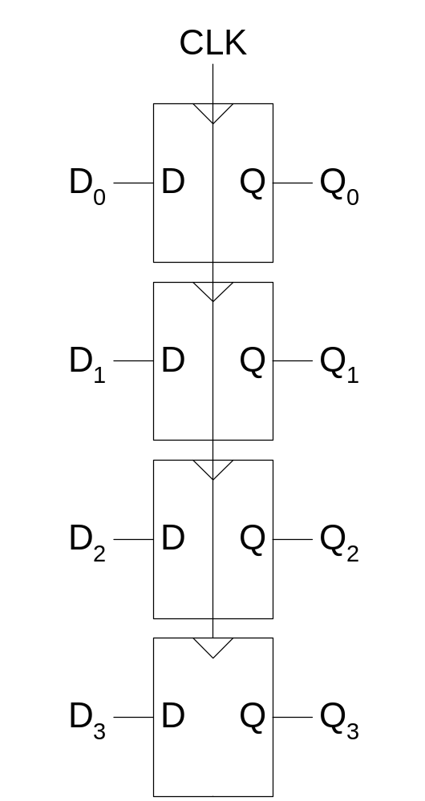
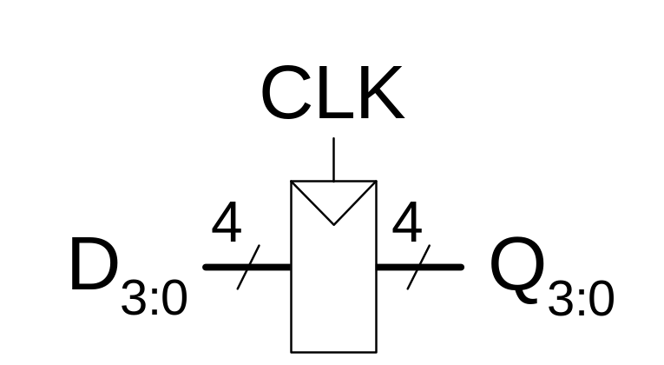
Registers
Copyright © 2007 Elsevier
3-<<number>>

Slide 20
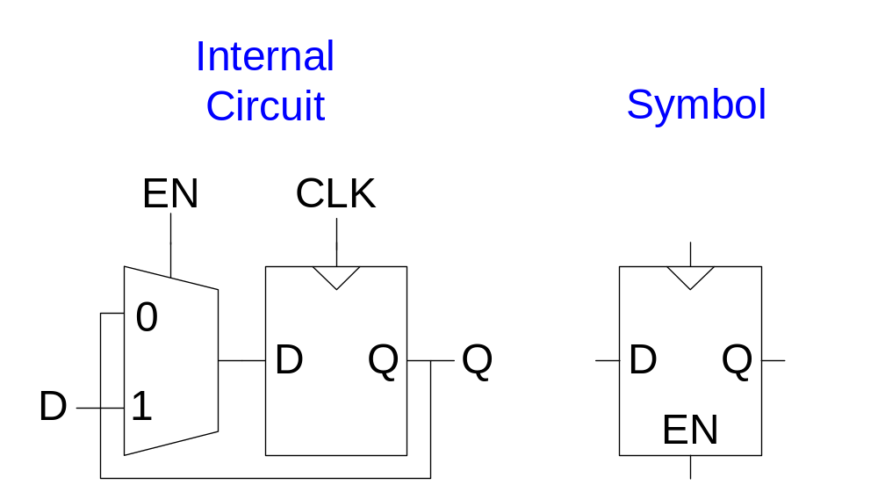
Enabled Flip-Flops
Inputs: CLK, D, EN
The enable input (EN) controls when new data (D) is stored
When EN = 1
  D passes through to Q on the clock edge
When EN = 0
  the flip-flop retains its previous state
Copyright © 2007 Elsevier
3-<<number>>

Slide 21
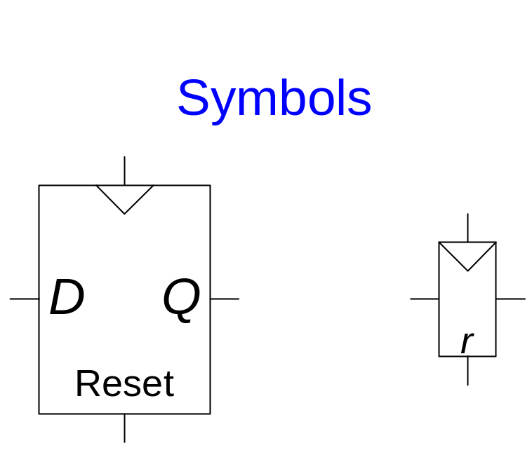
Resettable Flip-Flops
Inputs: CLK, D, Reset
When Reset = 1
  Q is reset to 0
When Reset = 0
  the flip-flop behaves like an ordinary D flip-flop
Copyright © 2007 Elsevier
3-<<number>>

Slide 22
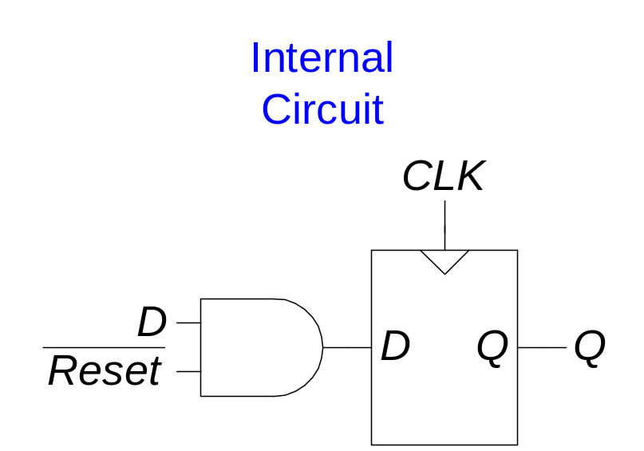
Resettable Flip-Flops
Two types:
  Synchronous: resets at the clock edge only
  Asynchronous: resets immediately when Reset = 1
Synchronously resettable flip-flop requires changing the internal circuitry of the flip-flop (see Exercise 3.10)
Asynchronously resettable flip-flop:
Copyright © 2007 Elsevier
3-<<number>>

Slide 23
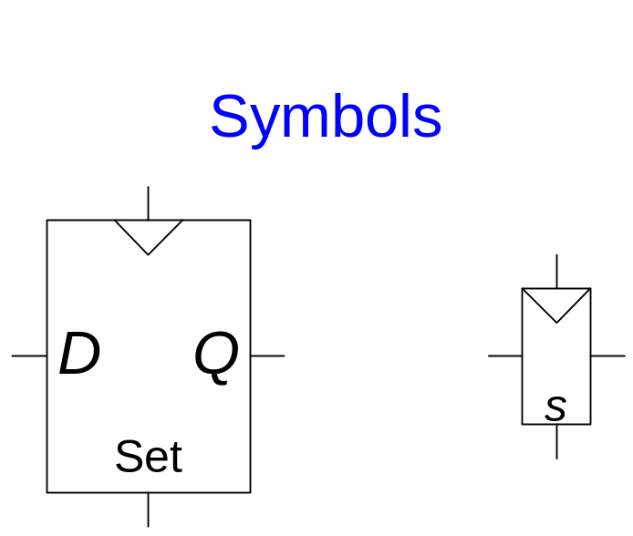
Settable Flip-Flops
Inputs: CLK, D, Set
When Set = 1
  Q is set to 1
When Set = 0
  the flip-flop behaves like an ordinary D flip-flop
Copyright © 2007 Elsevier
3-<<number>>

Slide 24
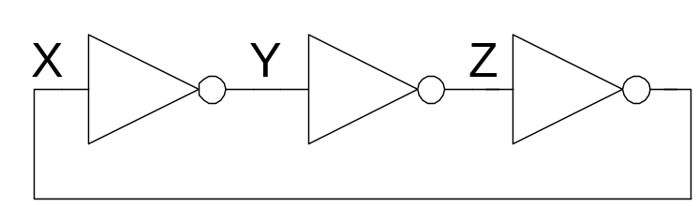
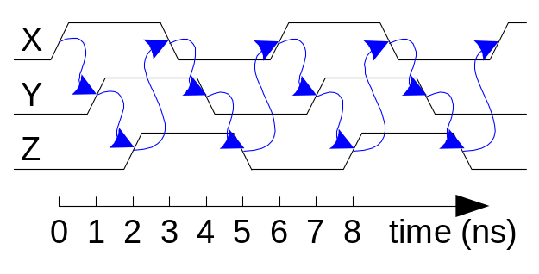
Sequential Logic
Sequential circuits: all circuits that aren’t combinational
A problematic circuit:
This circuit has no inputs and 1-3 outputs.
It is an astable circuit that oscillates.
Its period depends on the delay of the inverters – which depends on the manufacturing process, temperature, etc.
The circuit has a cyclic path: output fed back to input
Copyright © 2007 Elsevier
3-<<number>>

Slide 25
Synchronous Sequential Logic Design
Breaks cyclic paths by inserting registers
These registers contain the state of the system
The state changes at the clock edge, so we say the system is synchronized to the clock
Rules of synchronous sequential circuit composition:
  Every circuit element is either a register or a combinational circuit
  At least one circuit element is a register.
  All registers receive the same clock signal.
  Every cyclic path contains at least one register.
Two common synchronous sequential circuits
  Finite state machines (FSMs)
  Pipelines
Copyright © 2007 Elsevier
3-<<number>>

Slide 26
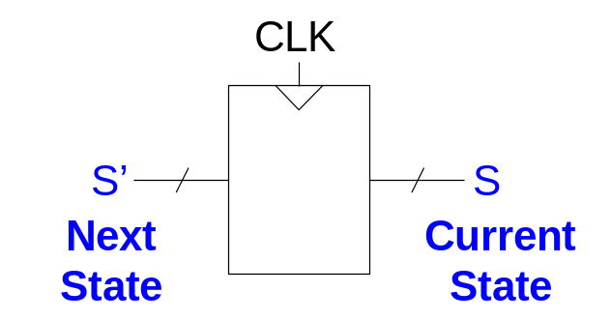
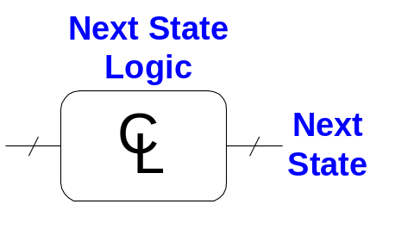
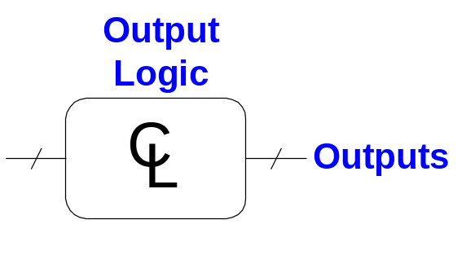
Finite State Machine (FSM)
Consists of:
  State register that
    Store the current state and
    Load the next state at the clock edge
  Combinational logic that
    Computes the next state
    Computes the outputs
Copyright © 2007 Elsevier
3-<<number>>

Slide 27
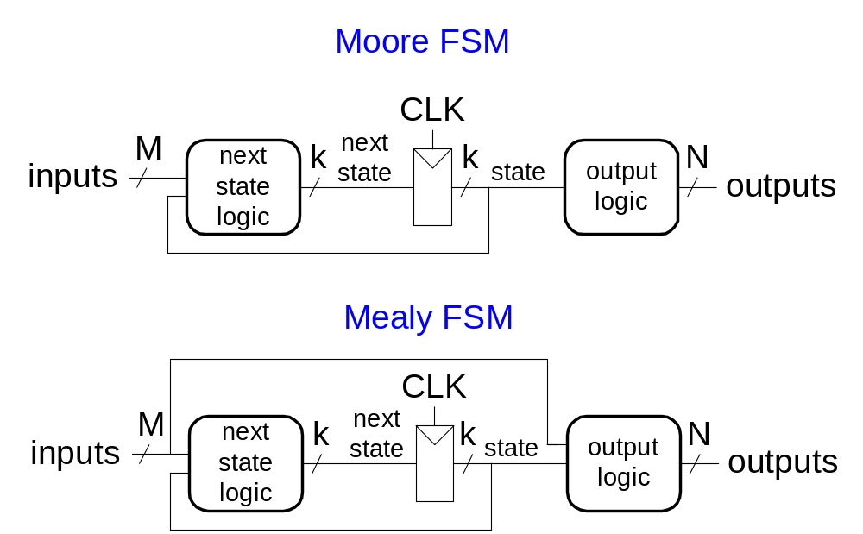
Finite State Machines (FSMs)
(유한 상태 기계)
Next state is determined by the current state and the inputs
Two types of finite state machines differ in the output logic:
  Moore FSM: outputs depend only on the current state
  Mealy FSM: outputs depend on the current state and the inputs
Copyright © 2007 Elsevier
3-<<number>>

Slide 28
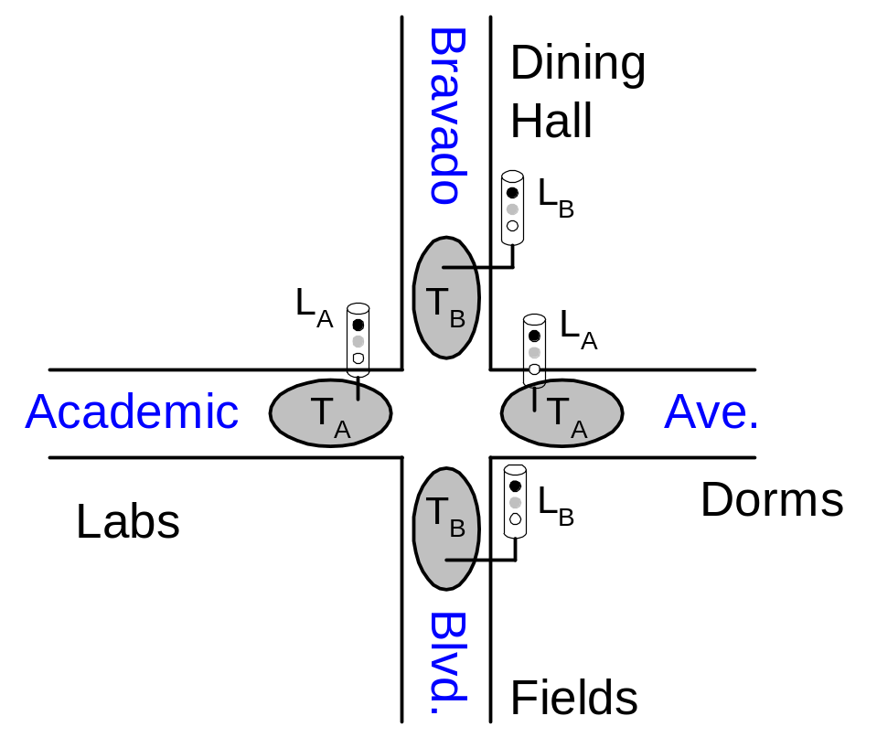
Finite State Machine Example
Traffic light controller
  Traffic sensors: T_{A}, T_{B} (TRUE when there’s traffic)
  Lights: L_{A}, L_{B}
Copyright © 2007 Elsevier
3-<<number>>

Slide 29
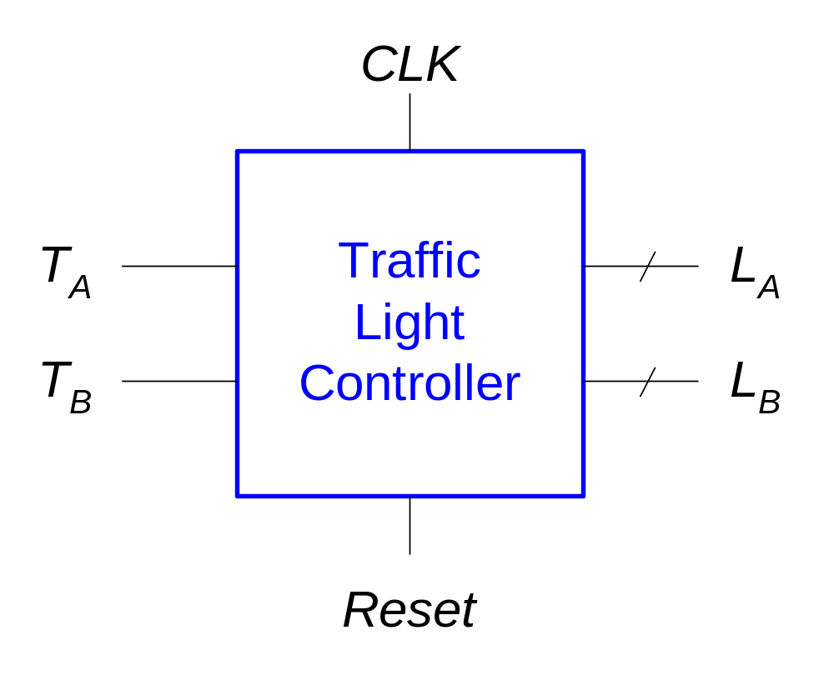
FSM Black Box
Inputs: CLK, Reset, T_{A}, T_{B}
Outputs: L_{A}, L_{B}
Copyright © 2007 Elsevier
3-<<number>>

Slide 30
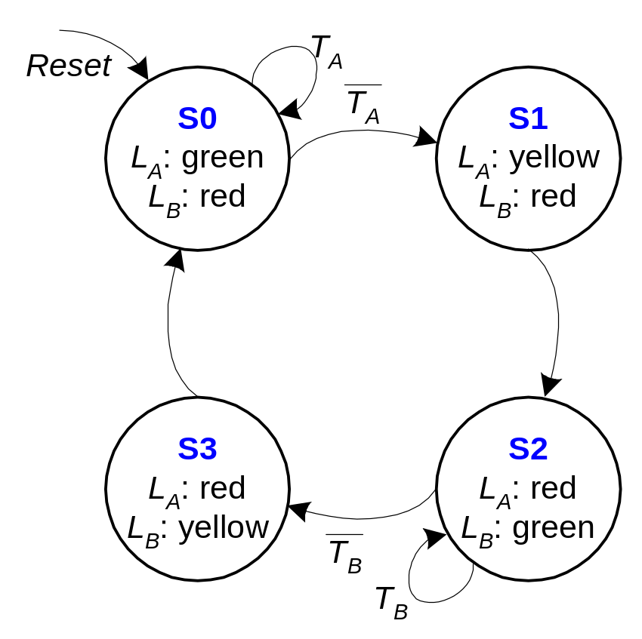
FSM State Transition Diagram
Moore FSM: outputs labeled in each state
States: Circles
Transitions: Arcs
Copyright © 2007 Elsevier
3-<<number>>

Slide 31
FSM State Transition Table
Current State | Inputs |  | Next State
S | T_{A} | T_{B} | S'
S0 | 0 | X | S1
S0 | 1 | X | S0
S1 | X | X | S2
S2 | X | 0 | S3
S2 | X | 1 | S2
S3 | X | X | S0
Copyright © 2007 Elsevier
3-<<number>>

Slide 32
FSM Encoded State Transition Table
Current State |  | Inputs |  | Next State
S₁ | S₀ | T_{A} | T_{B} | S'₁ | S'₀
0 | 0 | 0 | X | 0 | 1
0 | 0 | 1 | X | 0 | 0
0 | 1 | X | X | 1 | 0
1 | 0 | X | 0 | 1 | 1
1 | 0 | X | 1 | 1 | 0
1 | 1 | X | X | 0 | 0
State | Encoding
S0 | 00
S1 | 01
S2 | 10
S3 | 11
S'₁ = S₁ ⊕ S₀
S'₀ = S₁S₀T_{A} + S₁S₀T_{B}
Copyright © 2007 Elsevier
3-<<number>>

Slide 33
FSM Output Table
Current State |  | Outputs
S₁ | S₀ | L_{A1} | L_{A0} | L_{B1} | L_{B0}
0 | 0 | 0 | 0 | 1 | 0
0 | 1 | 0 | 1 | 1 | 0
1 | 0 | 1 | 0 | 0 | 0
1 | 1 | 1 | 0 | 0 | 1
Output | Encoding
green | 00
yellow | 01
red | 10
L_{A1} = S₁
L_{A0} = S₁S₀
L_{B1} = S₁
L_{B0} = S₁S₀
Copyright © 2007 Elsevier
3-<<number>>

Slide 34
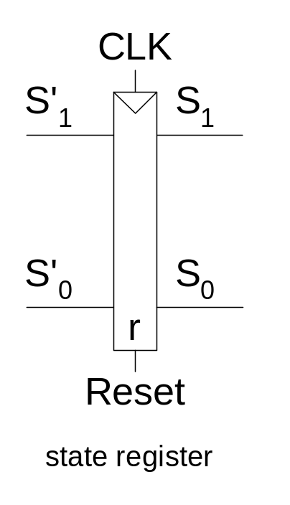
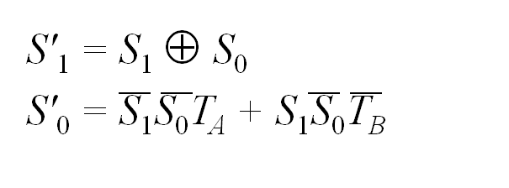
FSM Schematic: State Register
Copyright © 2007 Elsevier
3-<<number>>

Slide 35
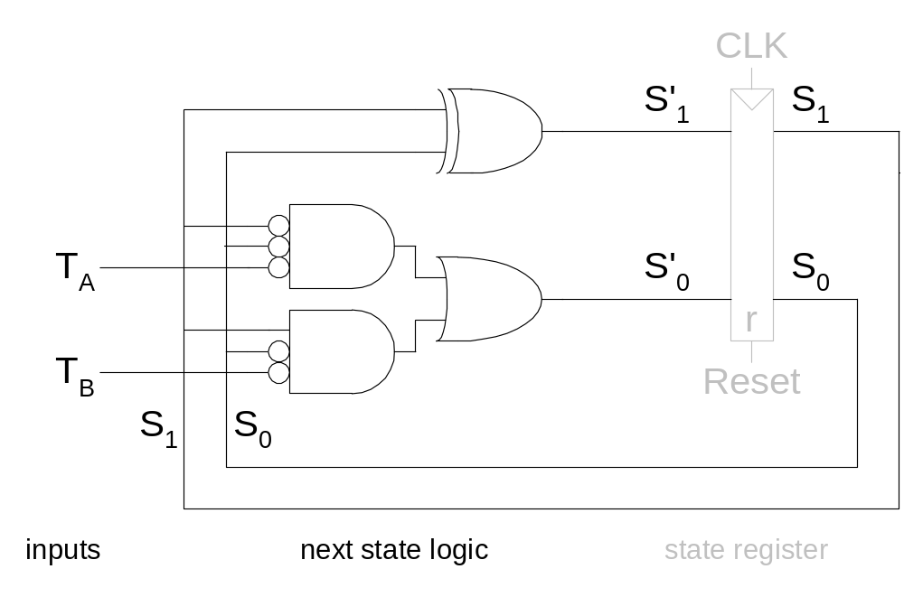
FSM Schematic: Next State Logic
Copyright © 2007 Elsevier
3-<<number>>

Slide 36
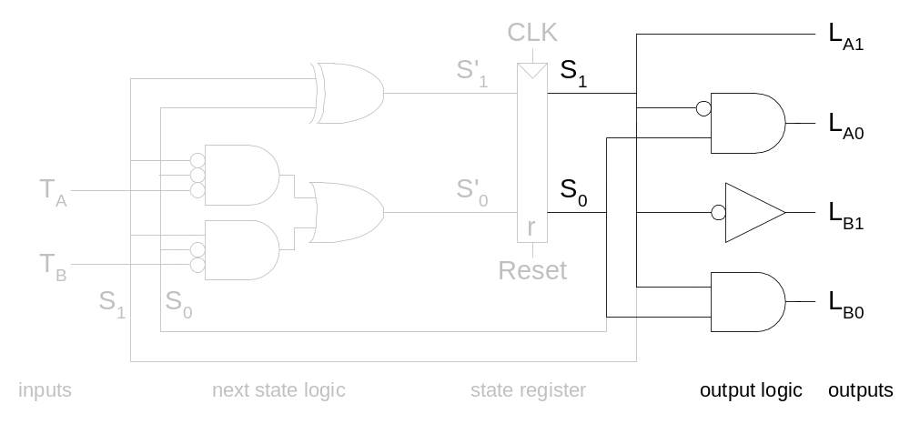
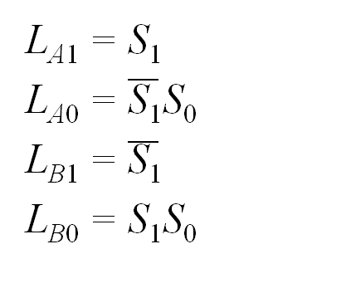
FSM Schematic: Output Logic
Copyright © 2007 Elsevier
3-<<number>>

Slide 37
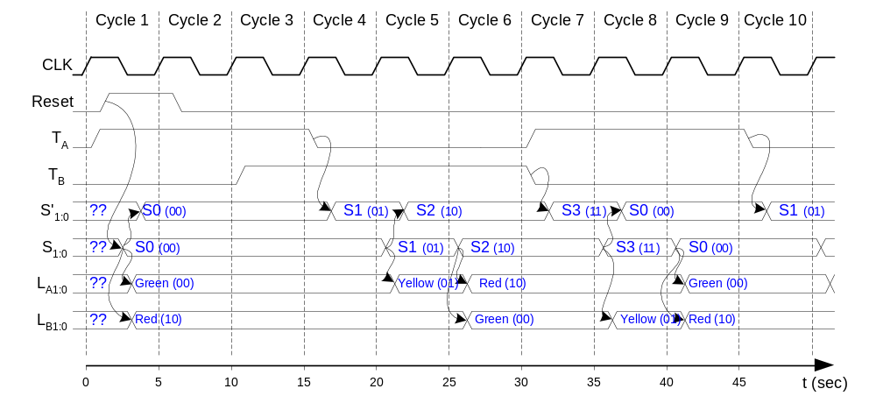
FSM Timing Diagram
Copyright © 2007 Elsevier
3-<<number>>

Slide 38
FSM State Encoding
Binary encoding: i.e., for four states, 00, 01, 10, 11
One-hot encoding
  One state bit per state
  Only one state bit is HIGH at once
  I.e., for four states, 0001, 0010, 0100, 1000
  Requires more flip-flops
  Often next state and output logic is simpler
Copyright © 2007 Elsevier
3-<<number>>

Slide 39
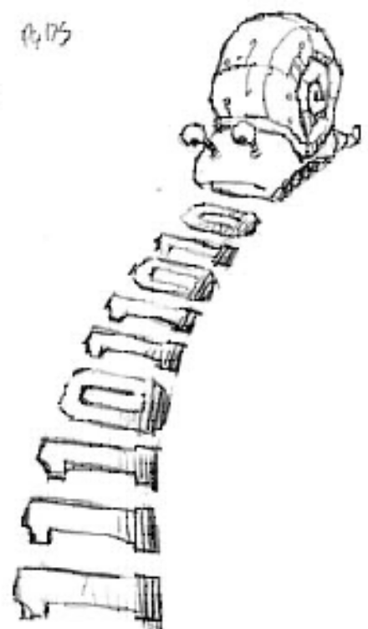
Moore vs. Mealy FSM
Alyssa P. Hacker has a snail(달팽이) that crawls down (엉금 엉금 기어가다) a paper tape with 1’s and 0’s on it. The snail smiles whenever the last four digits it has crawled over are 1101. Design Moore and Mealy FSMs of the snail’s brain.
Copyright © 2007 Elsevier
3-<<number>>

Slide 40
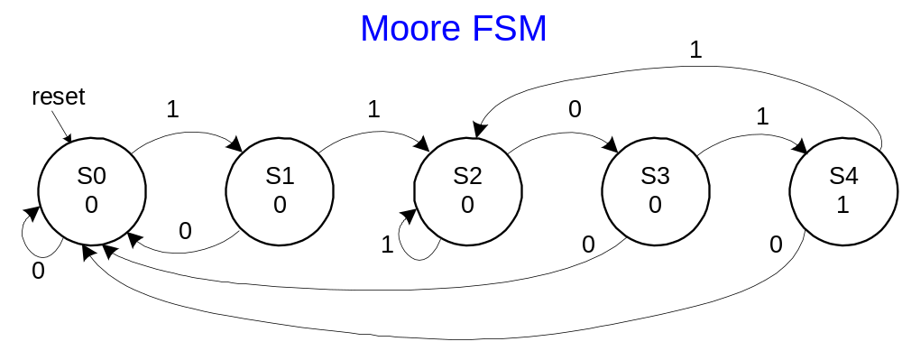
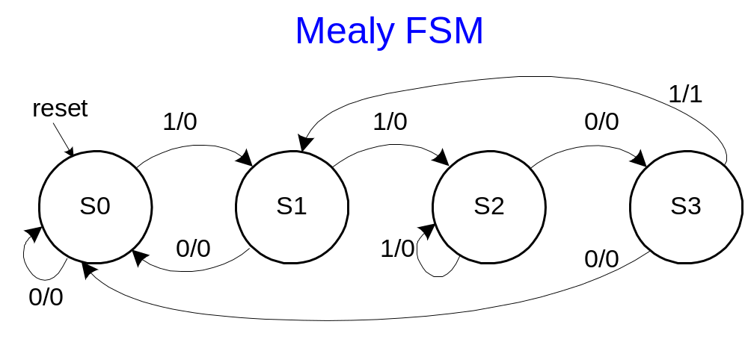
State Transition Diagrams
Mealy FSM: arcs indicate input/output
Copyright © 2007 Elsevier
3-<<number>>

Slide 41
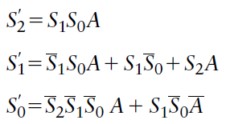
Moore FSM State Transition Table
Current State |  |  | Inputs | Next State
S₂ | S₁ | S₀ | A | S'₂ | S'₁ | S'₀
0 | 0 | 0 | 0 | 0 | 0 | 0
0 | 0 | 0 | 1 | 0 | 0 | 1
0 | 0 | 1 | 0 | 0 | 0 | 0
0 | 0 | 1 | 1 | 0 | 1 | 0
0 | 1 | 0 | 0 | 0 | 1 | 1
0 | 1 | 0 | 1 | 0 | 1 | 0
0 | 1 | 1 | 0 | 0 | 0 | 0
0 | 1 | 1 | 1 | 1 | 0 | 0
1 | 0 | 0 | 0 | 0 | 0 | 0
1 | 0 | 0 | 1 | 0 | 1 | 0
State | Encoding
S0 | 000
S1 | 001
S2 | 010
S3 | 011
S4 | 100
Copyright © 2007 Elsevier
3-<<number>>

Slide 42
Moore FSM Output Table
Current State |  |  | Output
S₂ | S₁ | S₀ | Y
0 | 0 | 0 | 0
0 | 0 | 1 | 0
0 | 1 | 0 | 0
0 | 1 | 1 | 0
1 | 0 | 0 | 1
Y = S₂
Copyright © 2007 Elsevier
3-<<number>>

Slide 43
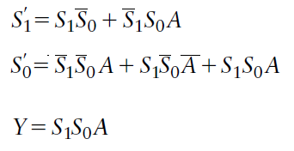
Mealy FSM State Transition and Output Table
Current State |  | Input | Next State |  | Output
S₁ | S₀ | A | S'₁ | S'₀ | Y
0 | 0 | 0 | 0 | 0 | 0
0 | 0 | 1 | 0 | 1 | 0
0 | 1 | 0 | 0 | 0 | 0
0 | 1 | 1 | 1 | 0 | 0
1 | 0 | 0 | 1 | 1 | 0
1 | 0 | 1 | 1 | 0 | 0
1 | 1 | 0 | 0 | 0 | 0
1 | 1 | 1 | 0 | 1 | 1
State | Encoding
S0 | 00
S1 | 01
S2 | 10
S3 | 11
Copyright © 2007 Elsevier
3-<<number>>

Slide 44
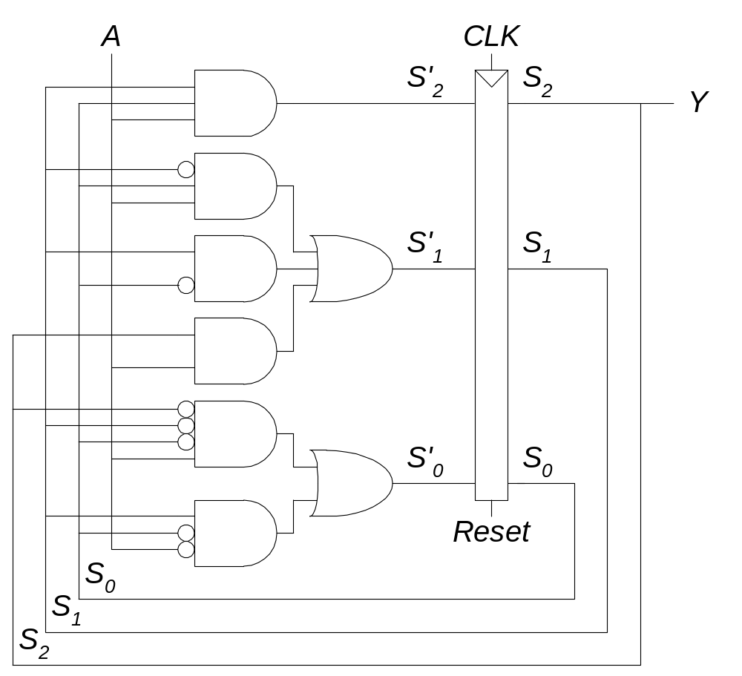
Moore FSM Schematic
Copyright © 2007 Elsevier
3-<<number>>

Slide 45
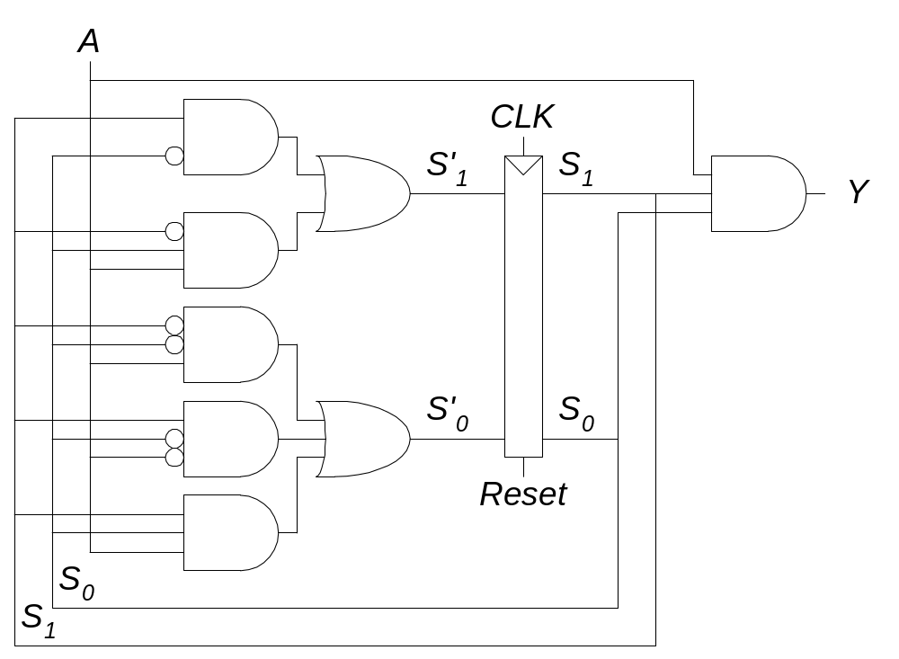
Mealy FSM Schematic
Copyright © 2007 Elsevier
3-<<number>>

Slide 46
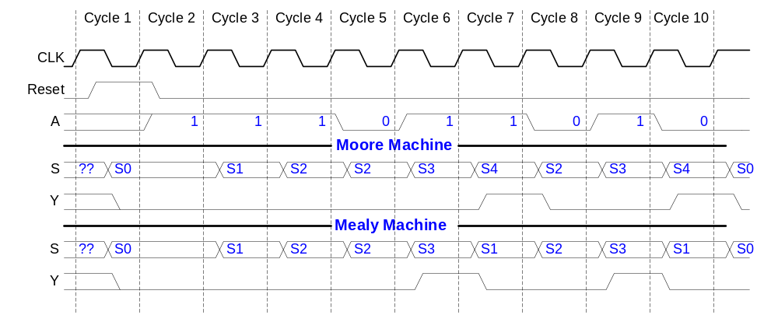
Moore and Mealy Timing Diagram
Copyright © 2007 Elsevier
3-<<number>>

